Slide 1
2023.08.29
AI 절차서 검증 시스템 회의 자료

Slide 2
Contents
Paragraph
RUN
- Handwriting and Case
TABLE
- Structure and Text
Format Text
- Data Frame Configuration
Place Keeping
-Type A
-Type B
-hierarchical relationship
-Alignment
-Location
Natural language processing
-Apply Module
DB Management
Loading

Slide 3
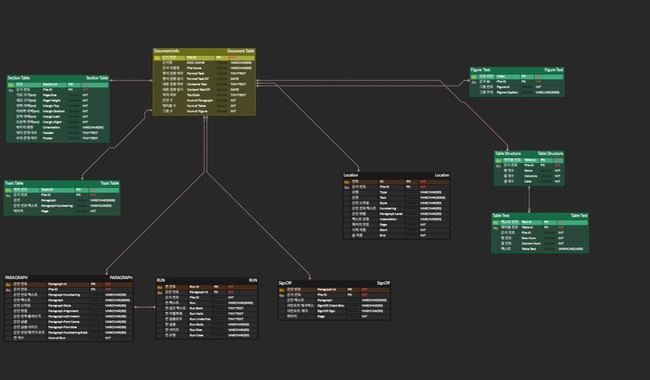
ERD

Slide 4
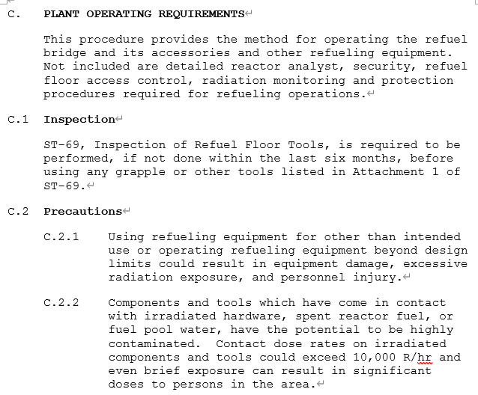
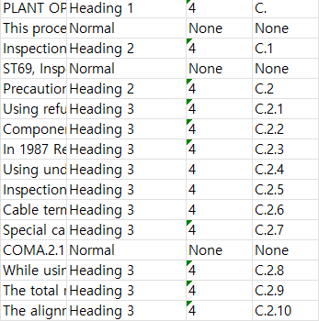
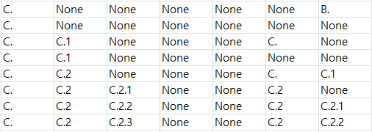
Paragraph hierarchical relationship
OP-66 R20
Paragraph
Paragraph Style
Numbering Style
Numbering Text
Top Title
Sub Title
Sub Title2
Sub Title3
Sub Title4
Parents Level
Prev Sbling Level
Page 33

Slide 5
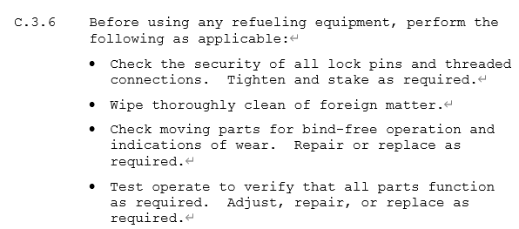
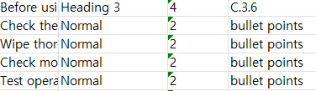

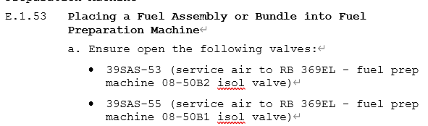


Paragraph hierarchical relationship
OP-66 R20
Bullets under Heading 3
Paragraph
Paragraph Style
Numbering Style
Numbering Text
Top Title
Sub Title
Sub Title2
Sub Title3
Sub Title4
Parents Level
Prev Sbling Level
Bullets under Heading 4
Paragraph
Paragraph Style
Numbering Style
Numbering Text
Top Title
Sub Title
Sub Title2
Sub Title3
Sub Title4
Parents Level
Prev Sbling Level
Page 35 / 75

Slide 6
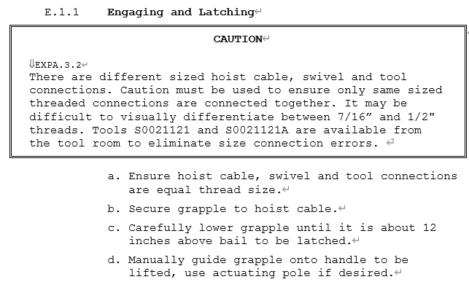
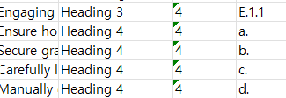

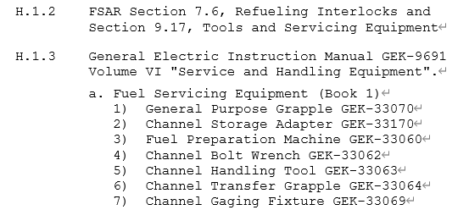
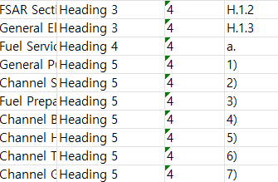
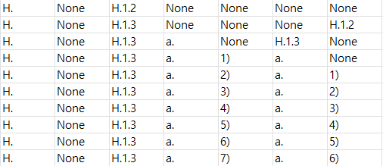
Paragraph hierarchical relationship
OP-66 R20
Paragraph
Paragraph Style
Numbering Style
Numbering Text
Top Title
Sub Title
Sub Title2
Sub Title3
Sub Title4
Parents Level
Prev Sbling Level
Paragraph
Paragraph Style
Numbering Style
Numbering Text
Top Title
Sub Title
Sub Title2
Sub Title3
Sub Title4
Parents Level
Prev Sbling Level
Page 39/ 82

Slide 7
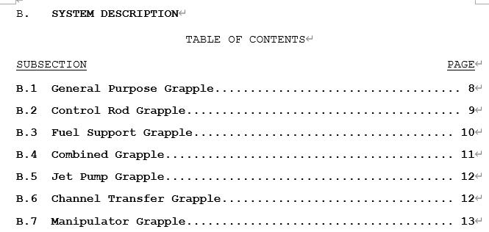

Paragraph Alignment
OP-66 R20
Page 6

Slide 8
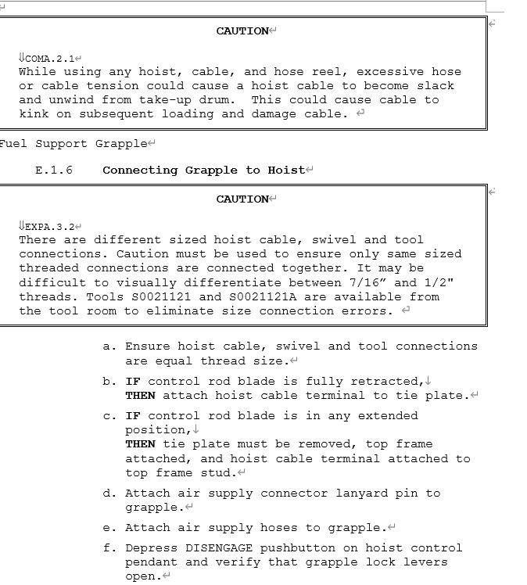
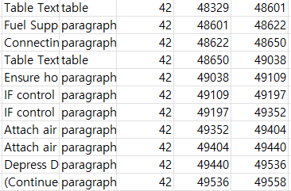
Paragraph Location
OP-66 R20
Text
Type
Page Number
Start
End
Page 42

Slide 9
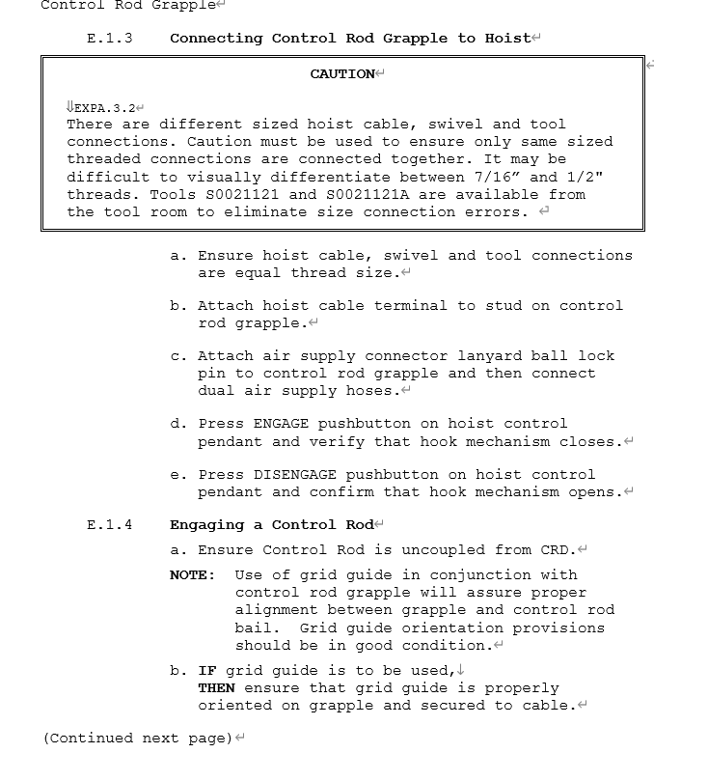
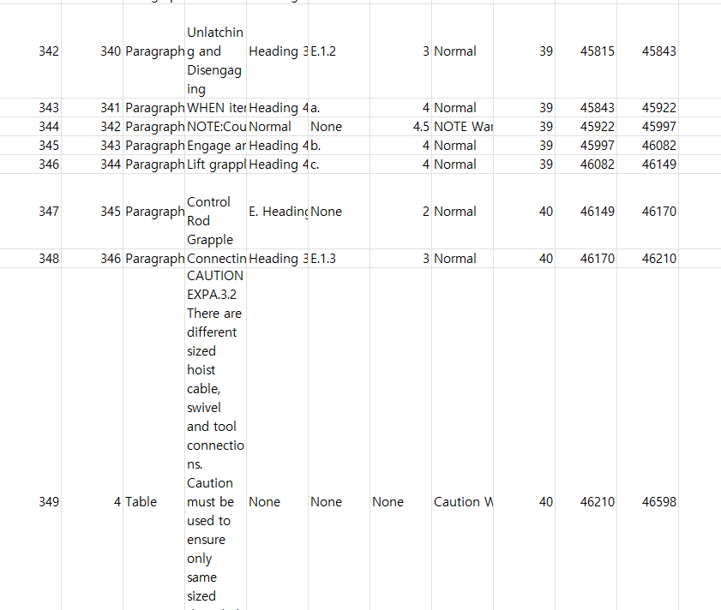
Paragraph Location
OP-66 R20
ID
Type
Text
Style
Numbering
Level
Indentation
Page Number
Start
End
Page 40

Slide 10
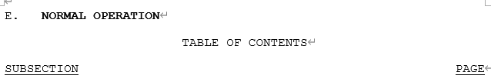


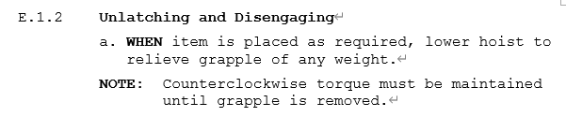


RUN Handwriting and Case
OP-66 R20
Paragraph ID
Text
Run Bold
Run Italic
Run Underline
Run Case
Paragraph ID
Text
Run Bold
Run Italic
Run Underline
Run Case
Page 37 ~ 39

Slide 11
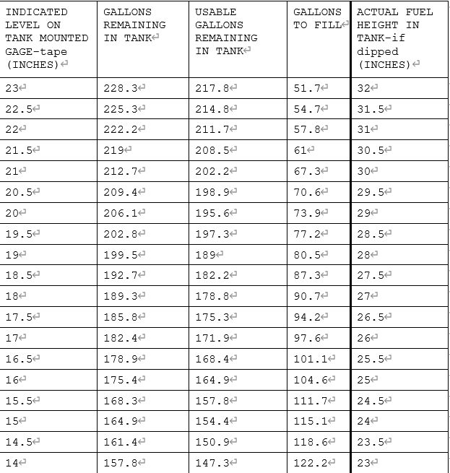
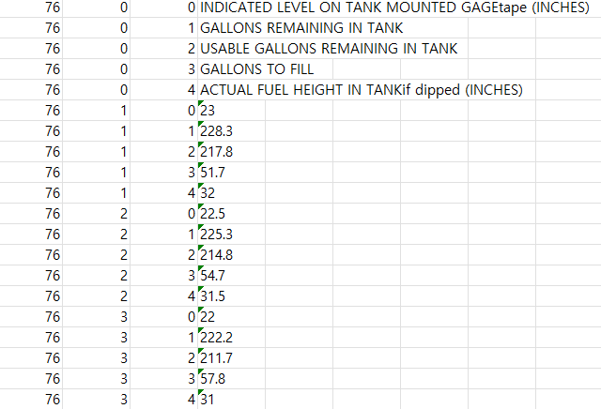
TABLE Structure and Text
OP-33 R59
Table ID
Rows
Columns
Cells
Table ID
Row Num
Column Num
Table Text
Page 37 ~ 39

Slide 12
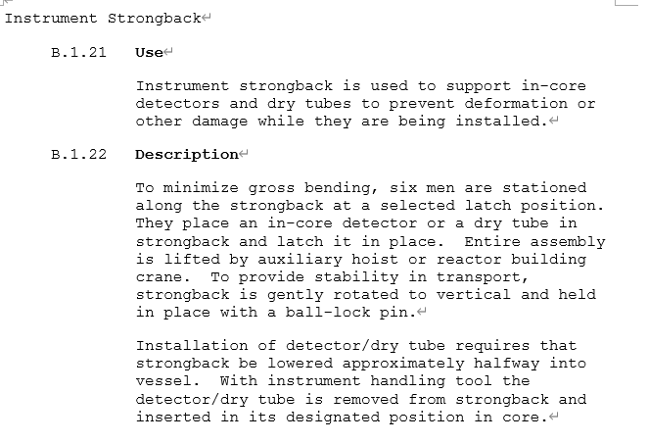

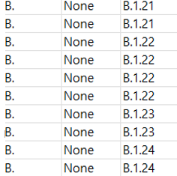
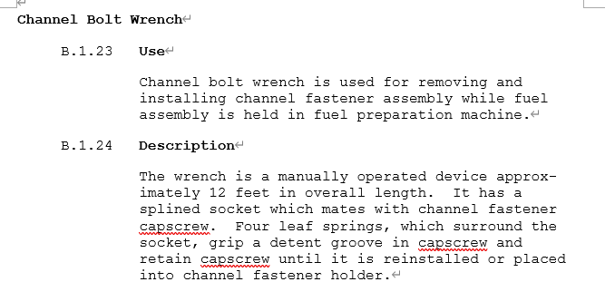
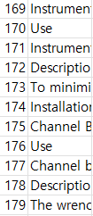
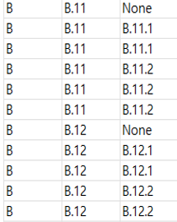
Format Text Data Frame Configuration
OP-66 R20
Page 15

Slide 13
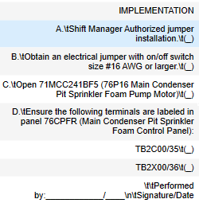
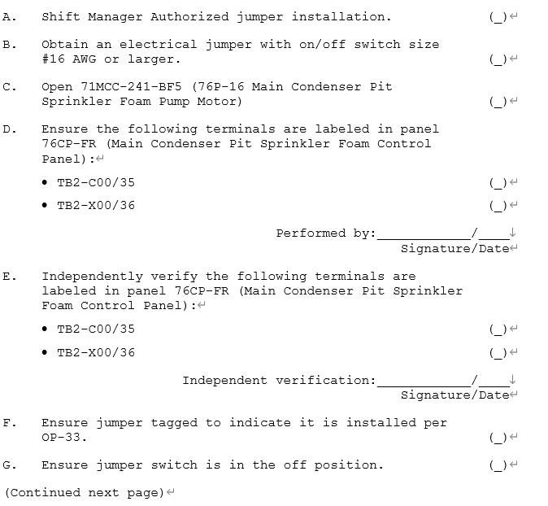
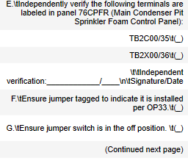
Place Keeping
Type A
OP-33 R59
Page 160

Slide 14
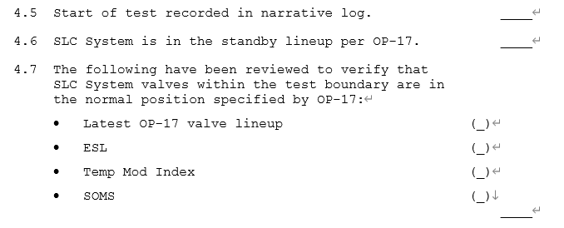
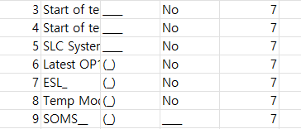
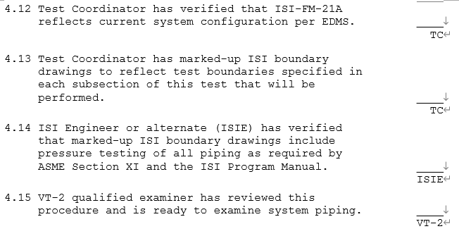
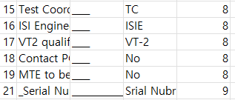
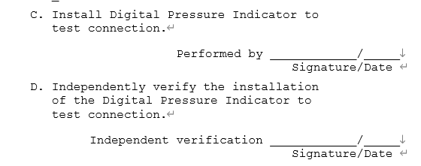


Place Keeping
Type A
ST-6KA. R3
Page 7/8/14/23

Slide 15
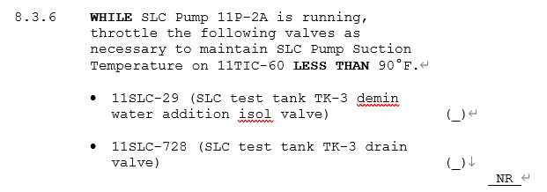
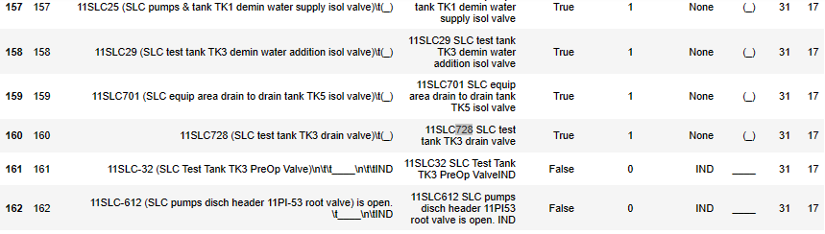
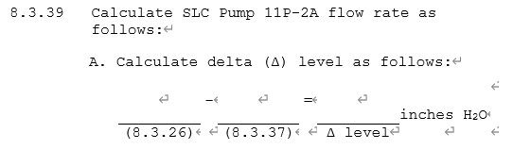
Place Keeping
Type B
ST-6KR R3
Page 21 / 27

Slide 16
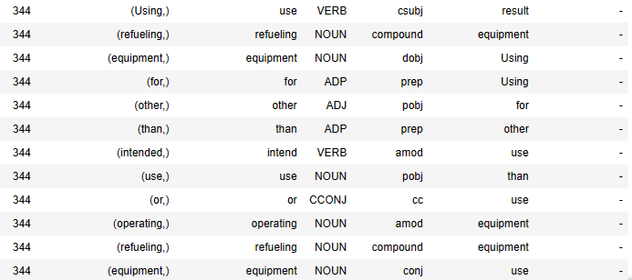
Natural language processing
-Apply Module
Paragraph ID
Token
Lemma
Dependency
Dependency Head
NER

Slide 17
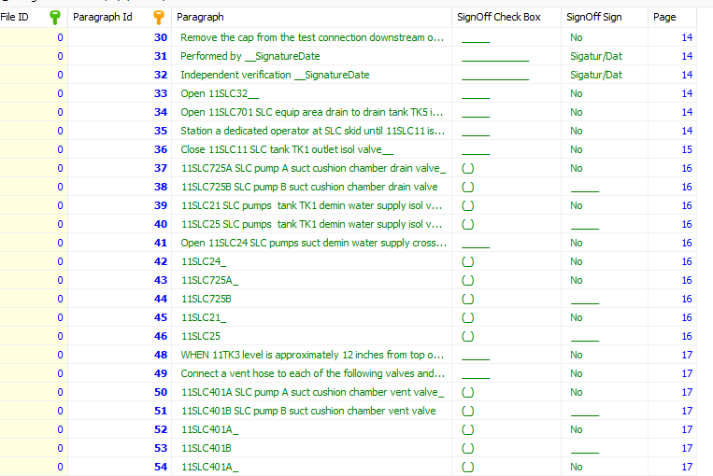
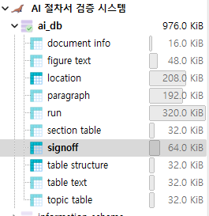
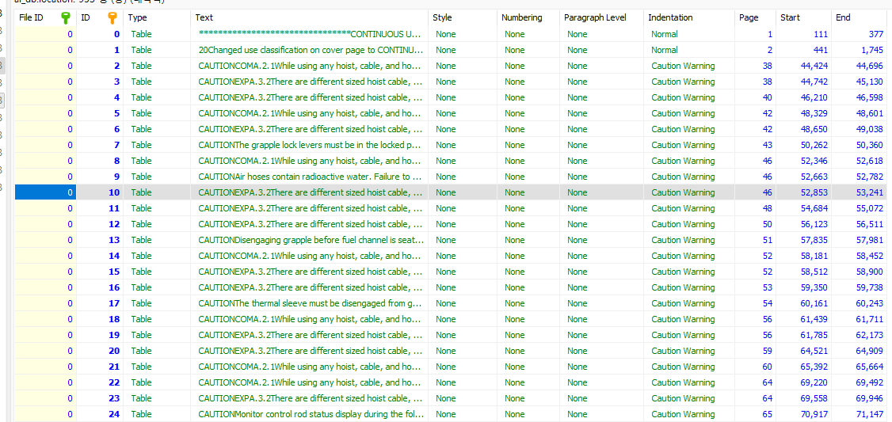
DB Management
Loading

